Slide 1
Study Room: E-learning QA Module
Prepared By :-
Abhinav Paudel(15449)
Mandeep Panta(15464)
Ashbin Thapa(15455)

Slide 2
Presentation Overview
Introduction
Problem Definition
Objective
Literature Review
Methodology
Tools Used
Working Division
Project Deliverables
Use Case Diagram
Conclusion
References

Slide 3
Introduction
Study Room is a question and answers website for programmers. This web application will act as the platform where developers can ask and answer technical questions related to programming, software development, and other technology-related topics.

Slide 4
Problem definition
Lack of easy to understand coding community for asking coding problem’s solutions.
Struggle to get authentic answer for the questions and determining the correct answers.

Slide 5
Objectives
The Website aims to:
To develop web application for asking and answering the questions related to various faculties.
To allow people to communicate to increase flow of information among them.
To Create an interactive and user friendly web-application which also helps in building a learning community

Slide 6
Literature Review
Quora is a Q&A platform that empowers people to share and grow the world’s knowledge. People come to Quora to ask questions about any subject, read high quality knowledge that's personalized and relevant to them, and share their own knowledge with others.
Stack overflow is a network of question-and-answer websites on topics in diverse fields to enable users to post questions and answer them. Users can vote on both answers and questions, and through this process users earn reputation points.
Yahoo Answers is one of the most popular Quora alternatives. It’s free to sign up for, and includes a sort of “game” system where you gain points for answering other people’s questions. This increases the number of questions that you can ask or answer per day.

Slide 7
Methodology
We worked following these methodologies for the application of knowledge, skills and technique to broad range of activities in order to meet the requirement of our project.
To complete this project, the following methodology / process has been conquered.
SOFTWARE DEVELOPMENT LIFE CYCLE
The framework we will be using for developing this project is Iterative model. Iterative model is simple and emphasizes on initial and simple implementation and with progress in the project it gains more feature. It is advantageous since it has unique feature of repetitive nature. The phases of the linear sequential model are: Analysis, Design, Testing and Implementation.

Slide 8
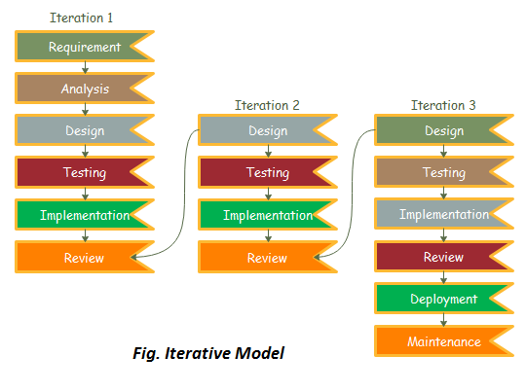
Iterative model

Slide 9
Tools Used
Tools | Purpose
Python | Whole application base creation platform
GitHub | To manage Source Code
Django | Framework of Python used to create web applications.
Android device | For Testing

Slide 10
Work Division
SN | NAME | ROLES | RESPONSIBILITIES
1 | Mandeep Panta. | System/Back-end developer | Test System Interfaces Define and execute development requirements Develop, maintain and implement policies and procedures necessary to ensure the security and integrity of the corporate database Develop website
2 | Abhinav Paudel | Front-end Developer And UI Designer | Develop Use-Friendly Interface and work through design revisions Evaluating existing applications and performing updates and modifications Develop Use-Friendly Interface and work through design revisions.
3 | Ashbin Thapa | Project Manager Documentation | Review and approve all project deliverables Day to Day responsibility to keep project on track for the successful delivery of Study Room System. Develop Documentation

Slide 11
Project Deliverables
Build web application with interface for User, and admin,
Users will be able to manage their profiles, including updating their personal information.,
Overall, the primary goal of a question-answer web application is to provide a user-friendly and efficient platform for users to ask and answer questions, share knowledge and information, and engage with a community of like-minded individuals.

Slide 12
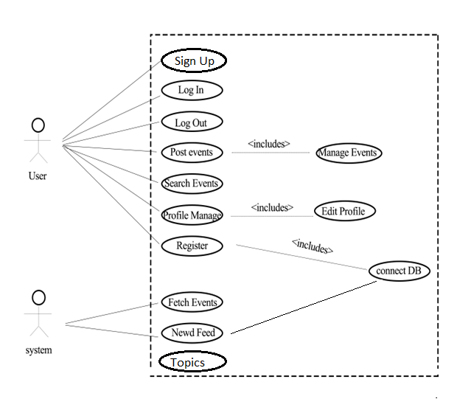
Use Case Diagram

Slide 13
Conclusion
Our system “STUDY ROOM” is now at initial phase with its beta version having most of the basic functionalities discussed before. All the modules have been working after integrating and are ready for the demo. As the features adding up the level of complexity has been increasing as well. However, it is not complete with the ideas we have put through and might need more improvisation in the upcoming days as well. This makes us think about the future extensions that we are going to implement in this system.

Slide 14
References
Reger S. Pressman, Ph.D. Seventh Edition, Software Engineering: A Practitioner’s Approach, McGraw Hill, 2010
Beginner Python Tutorial Available at: http://www.homeandlearn.co.uk/python/php.html(11.18.2018)
The Python Language Reference Manual (version 2.5) by Guido van Rossum, and Fred L. Drake, Jr. (Editor)
Python in a Nutshell by Alex Martelli.

Slide 15
THANK YOU

